Slide 1
Exploring restaurants in Tokyo
Abhinav Kumar Goswami

Slide 2
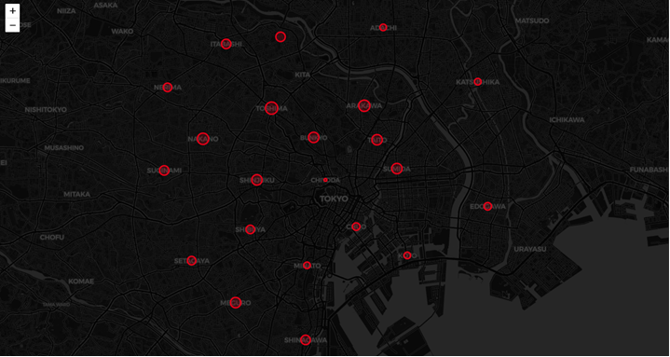
Map

Slide 3
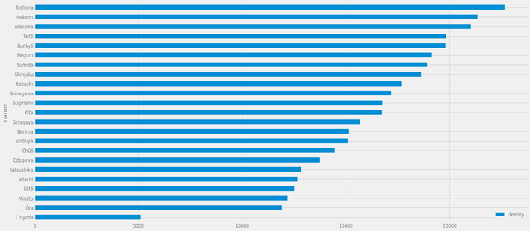
Plot (population density)

Slide 4
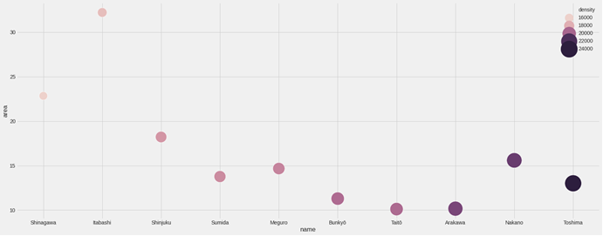
Scatter plot (density and area)

Slide 5
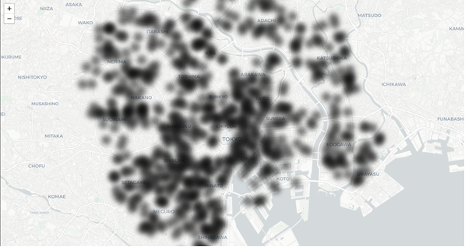
Heatmap(of restaurants)

Slide 6
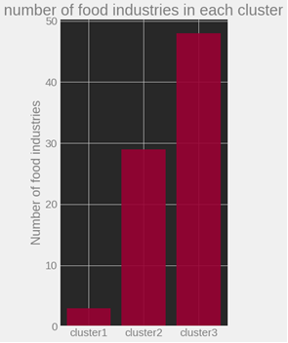
No. of food industries in the cluster
From the plot it is evident that the number of food industries (in top 10 venues) in cluster 1 is the least.
The no. of food industries in cluster 3 is highest.

Slide 7
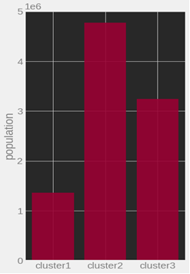
Population of clusters
The plot shows that the population of cluster 2 is more than that of cluster 3, depicting that cluster 2 is a residential area.

Slide 8
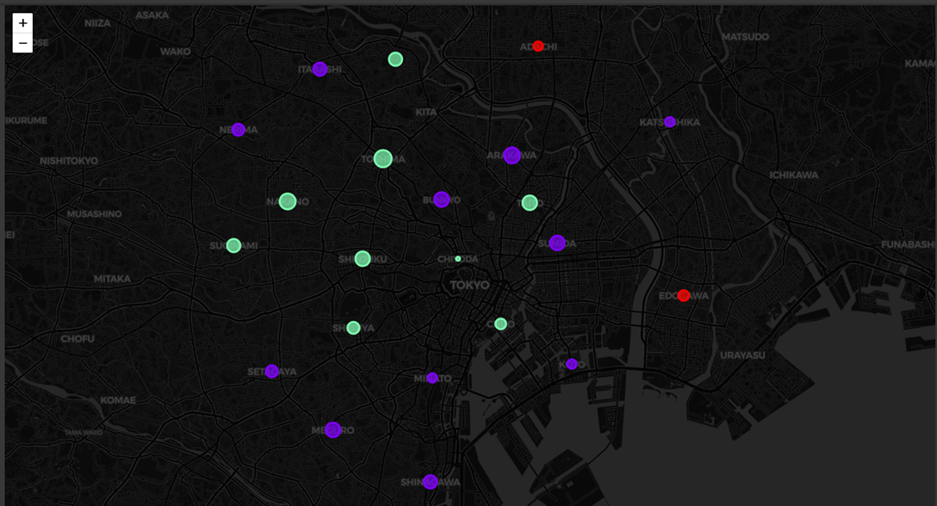
Result

Slide 9
Results
Cluster1- Districts in cluster1 have low population density, there aren’t many restaurants in cluster 1. The most common venues in cluster1 are convenience stores.
Cluster2- Cluster2 has high density, the most common venue in cluster2 is Convenience Store, there are good restaurants in cluster2.
Cluster3- Cluster3 has high population density and is famous for its restaurants.

Slide 10
Conclusion
Opening a restaurant in cluster3 where population density is between 15,000 and 20,000 would be a good idea.

Slide 11
Thank you

